Slide 1

BOOKING.COM CHALLENGE
GREAT
UNIHACK
2021
TEAM hornets

Slide 2
PART ONE
TRAINING OUR ML MODEL

Slide 3
RANDOM FOREST CLASSIFIER
collection of decision tree classifiers
ensemble learning method for classification, regression and other tasks
operates by constructing a multitude of decision trees at training time and merging them together → for regression tasks, the mean or average prediction of the individual trees is returned

Slide 4
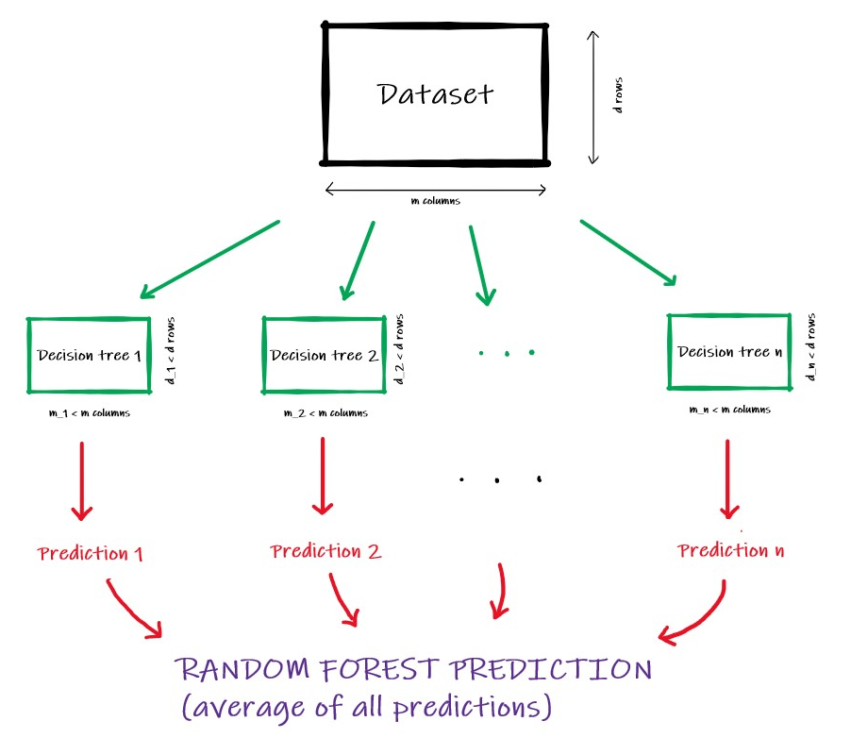
GRAPHIC REPRESENTATION OF THE RANDOM FOREST CLASSIFIER

Slide 5
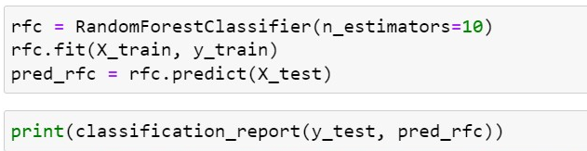
WHY PICK THAT MODEL?
flexible, easy to use
provides high accuracy through cross validation
overcomes overfitting of the tree model
generally greatly boosts the performance in the final model
downside: small increase in the bias and some loss of interpretability
choosing the number of trees considering the dataset size: 10

Slide 6
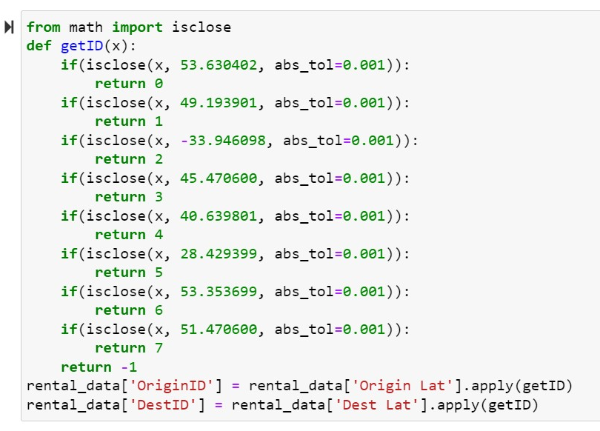
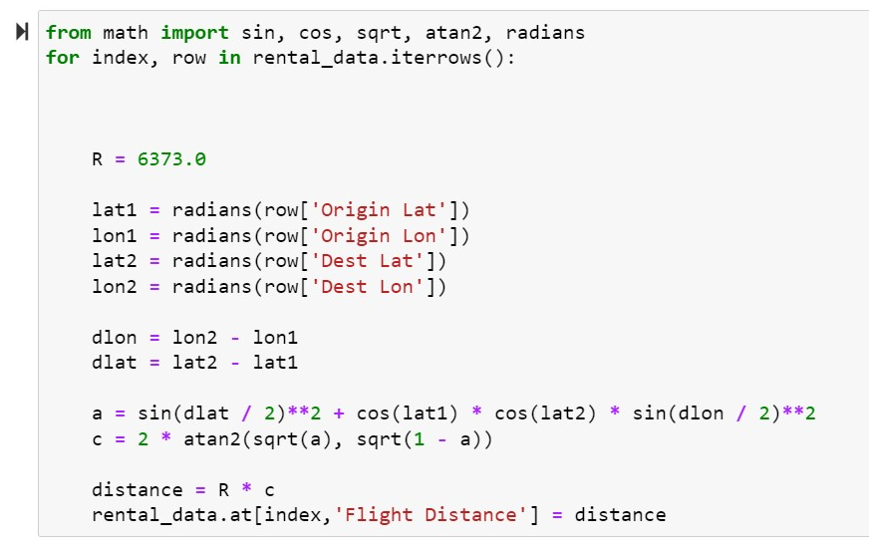
PARAMETERS
Booking Number, Price, Origin Lat, Origin Lon, Dest Lat, Dest Lon, Wait, Distance, Transport, Day, Date, Month, Year, Hour, Haul, Time Taken - given in dataset
DestID (based on Dest Lat and Dest Lon), OriginID (based on Origin Lat and Origin Lon), Flight Distance (based on the origin and destination coordinates) - our own
OriginID and DestID
calculating Flight Distance

Slide 7
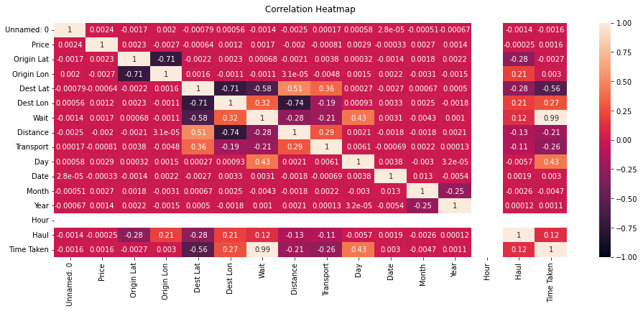
PARAMETERS AND THEIR CORRELATION

Slide 8
MAKING OUR MODEL
USED IN MODEL – WHY? | REJECTED – WHY?
DestID - different airports have different times based on size, popularity of location, connections with surrounding big cities | Booking Number/Price - have no influence over the waiting time at destination
Flight Distance – influences the passenger, therefore their time to go through security | OriginID – all passengers go through the same procedure when landing
Day - different days of the week influence the busyness of the airport | Year/Date/Month – the Correlation Heatmap showed that these parameters have almost no influence
Transport – buses have a bigger velocity than a walking person, but are more influenced by busy traffic | Distance – is tied to the destination airport so no need to use it again
Waiting time – the output of our program | Haul – is directly tied to the flight distance

Slide 9
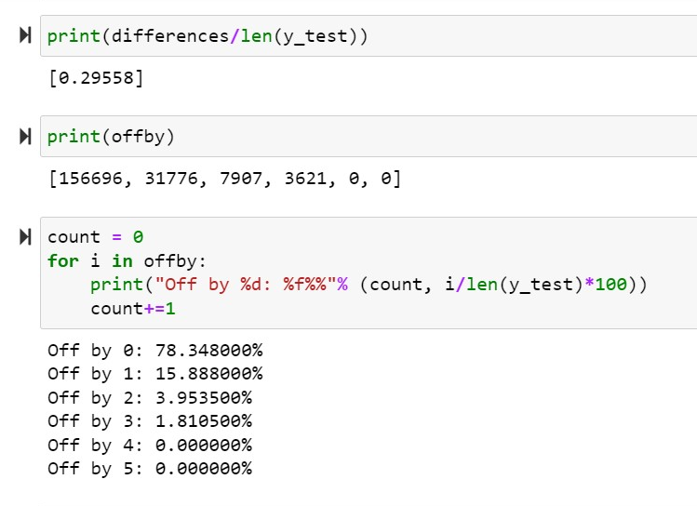
ACCURACY (IN MINUTES)
average error
numbers and percentages of results with 0-5 minute errors
On 200000 test cases! ☺

Slide 10
PART TWO
BUILDING THE
WEBSITE

Slide 11

Flask
micro web framework written in Python
flexible (allows experimentation), lightweight, fast results
simple, considering the amount of time we have

Slide 15
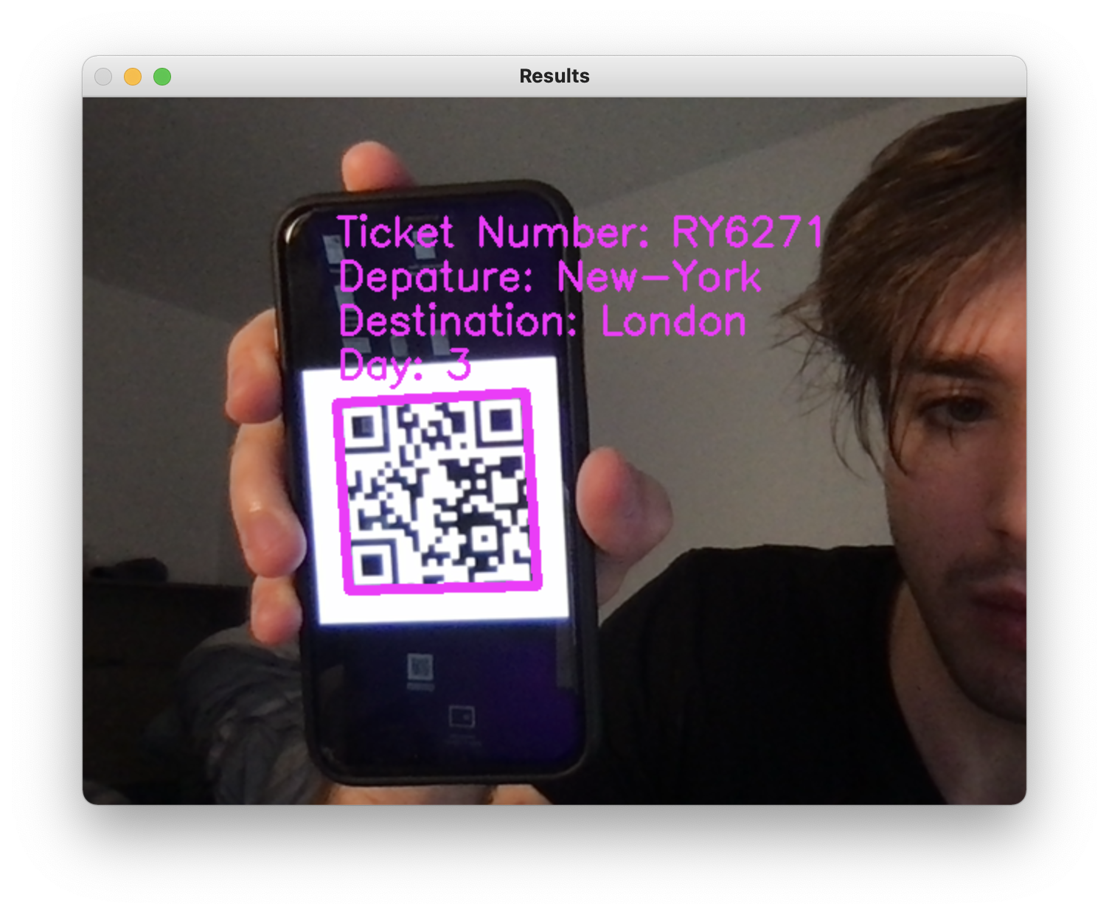
QR CODE IDEA
the code of the ticket
gives us its number, departure, destination and the day of the week

Slide 16
PART THREE
EXTRAS AND IMPROVEMENTS

Slide 17
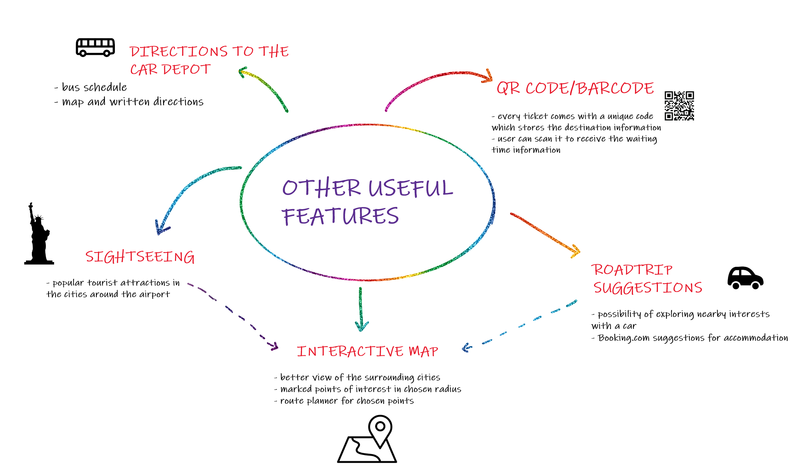

Slide 18
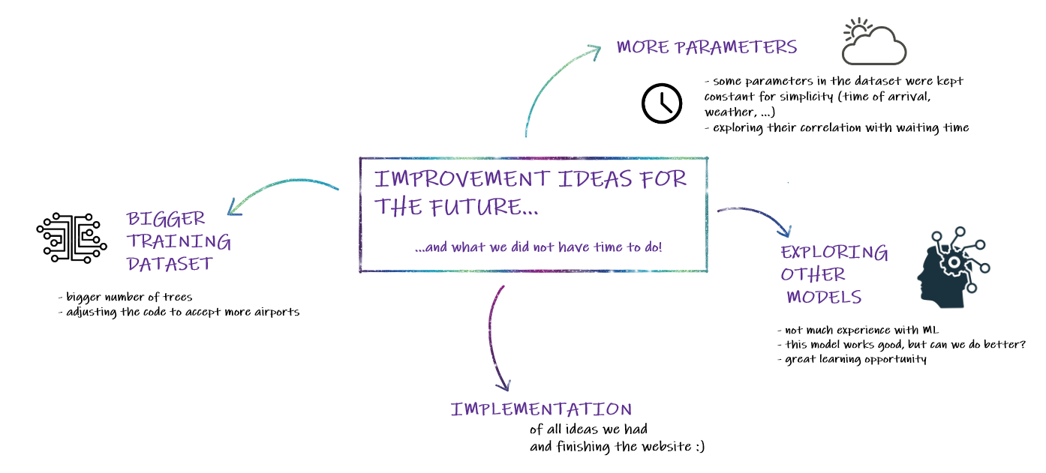

Slide 19

THE TEAM
Radu-Stefan Popovici (1st year of MEng Computer Science)
Mihnea Dumitru (2nd year of BSc Computer Science)
Nick Bispham (2nd year of BSc Computer Science and Mathematics)
Maja Drmač (2nd year of MMath Mathematics)

